Slide 1
Welcome
I am : sarthak prakash jadhav
I am here to present my problem statement.
Toothpaste Dispenser

Slide 2
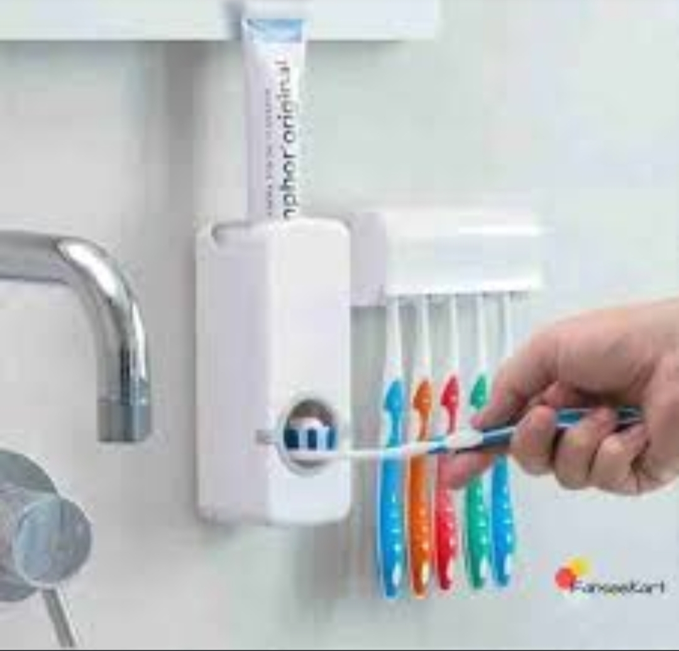
Problem statement
Toothpaste dispenser is expensive but we are making in low cost .

Slide 3
Solution
In this time all people want affordable things so for this
I am making affordable toothpaste dispenser that will be
Taking low cost for making and that why that will be in low
Cost for needed peoples .

Slide 4
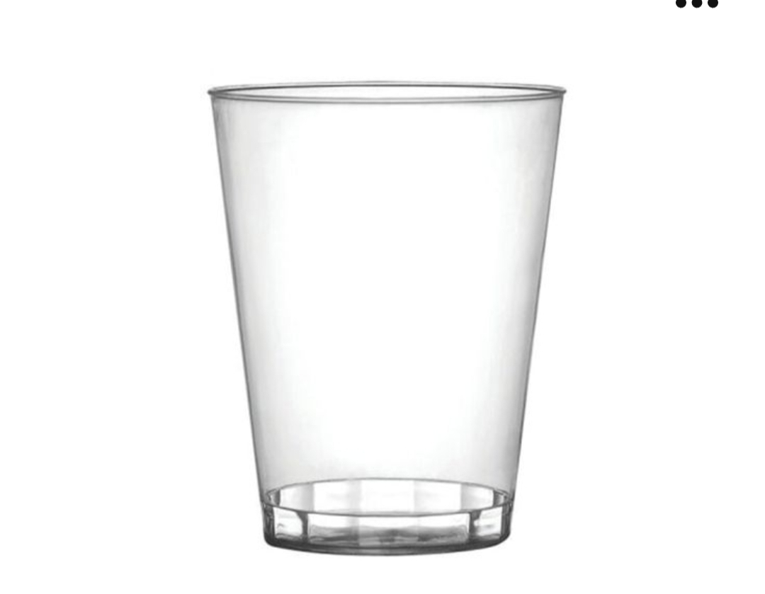
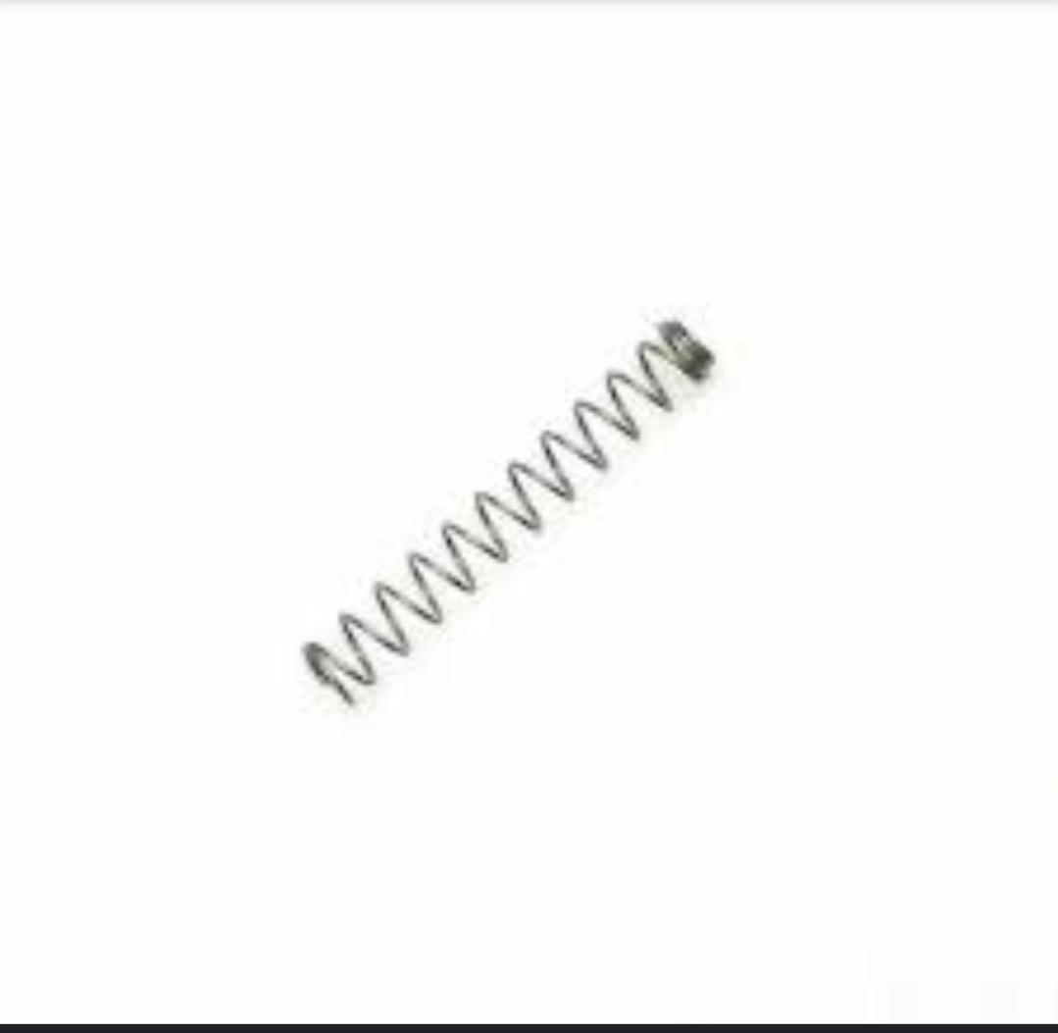
Required materials
Hard plastic cup
Spring from pen
Top of soap dispenser
Pieces of plastic
Silver spray paint
3-4 inch long nail

Slide 5
Working
Take one plastic cup, make a hole at middle length of
Cup.
Take a spring place in the hole of cup.
Take a piece of plastic such as ( spoon).
Also take 3-4 inch long nail .
When we put toothpaste inside the glass so spring will
Give pressure on toothpaste so that will come down.

Slide 6


